Slide 1
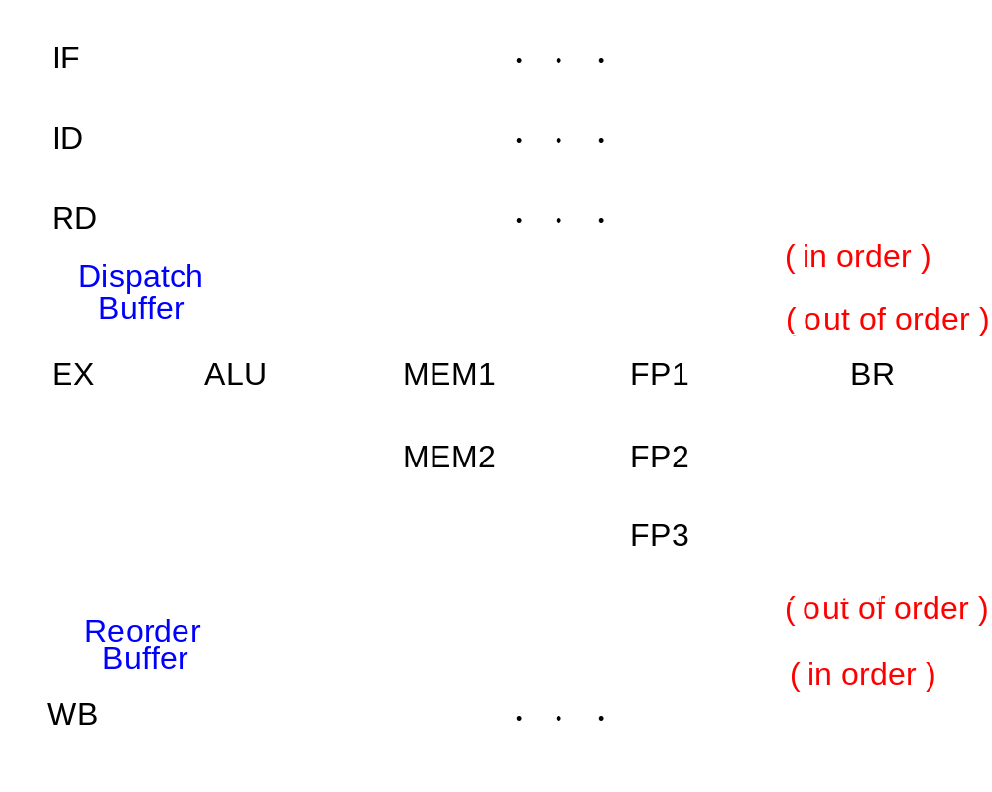
Dynamic Pipelines
Notes:
Like Wendy’s: once ID/RD has determined what you need, you get queued up, and others behind you can get past you.
In-order front end, OOO or dynamic execution in a micro-dataflow-machine, in-order backend
Interlock hardware (later) maintains dependences
Reorder buffer tracks completion, exceptions, provides precise interrupts: drain pipeline, restart
Inorder machine state follows the sequential execution model inherited from nonpipelined/pipelined machines

Slide 2
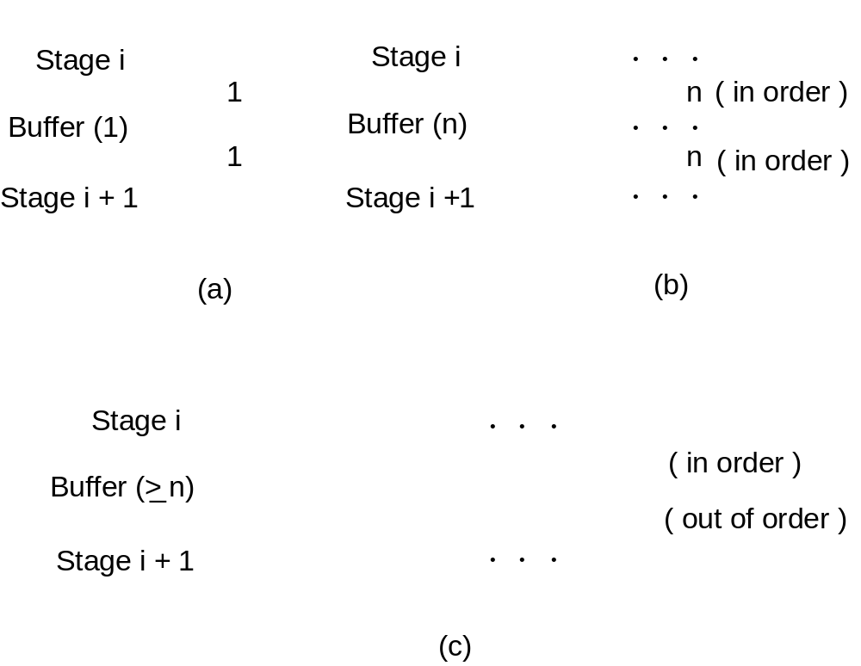
Interstage Buffers
Notes:
Key differentiator for OOO pipelines
Scalar pipe: just pipeline latches or flip-flops
In-order superscalar pipe: just wider ones
Out-of-order: start to look more like register files, with random access necessary, or shift registers.
May require effective crossbar between slots before/after buffer
May need to be a multiported CAM

Slide 3
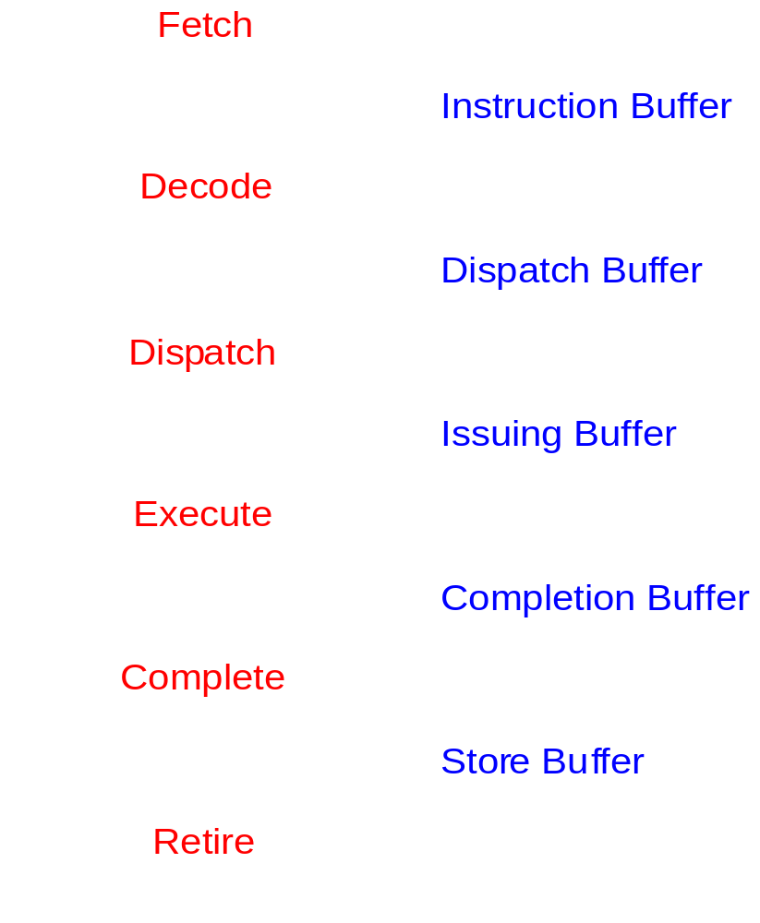
Superscalar Pipeline Stages
In
Program
Order
Out
of
Order
In
Program
Order

Slide 4
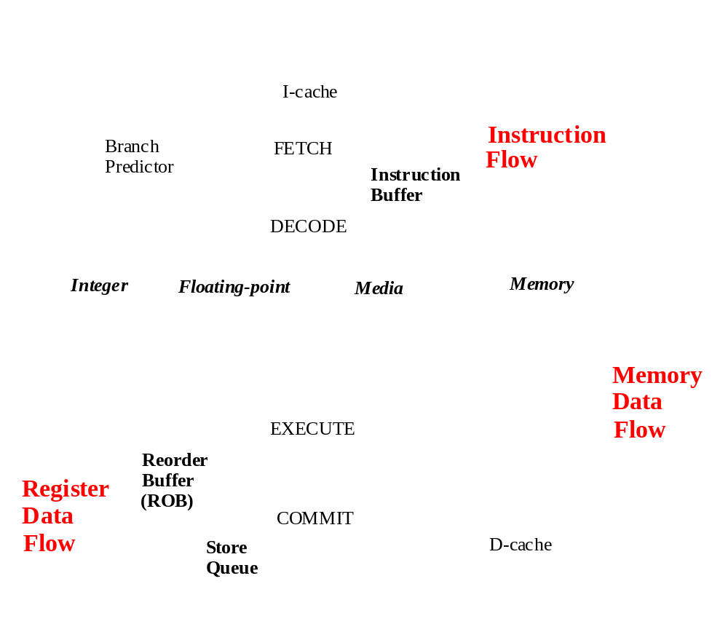
Impediments to High IPC

Slide 5
Superscalar Pipeline Design
Instruction Fetching Issues
Instruction Decoding Issues
Instruction Dispatching Issues
Instruction Execution Issues
Instruction Completion & Retiring Issues

Slide 6
Instruction Flow
Objective: Fetch multiple instructions per cycle
Challenges:
  Branches: control dependences
  Branch target misalignment
  Instruction cache misses
Solutions
  Code alignment (static vs.dynamic)
  Prediction/speculation
PC
Instruction Memory
3 instructions fetched
Notes:
Don’t starve the pipeline: n/cycle
Must fetch n/cycle from I$

Slide 7
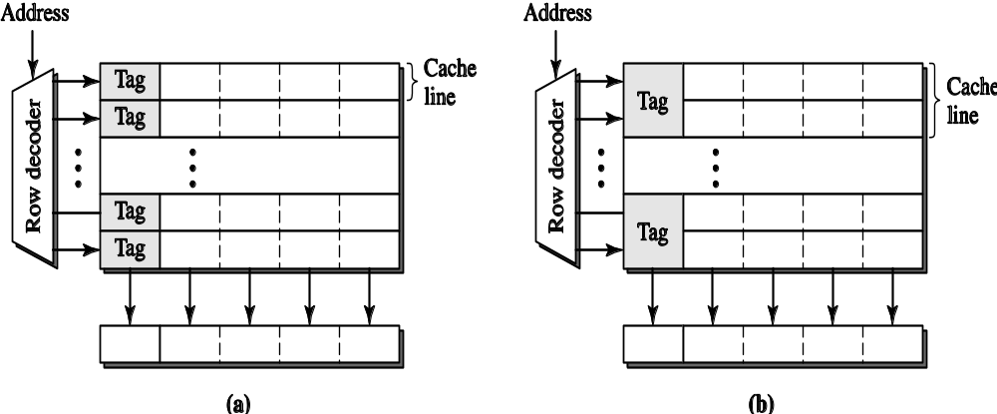
I-Cache Organization
1 cache line = 2 physical rows
Notes:
1 cache line == 1 physical row
1 cache line == 2 physical rows

Slide 8
Issues in Decoding
Primary Tasks
  Identify individual instructions (!)
  Determine instruction types
  Determine dependences between instructions
Two important factors
  Instruction set architecture
  Pipeline width
Notes:
RISC vs. CISC: inherently serial
Find branches early: redirect fetch
Detect dependences: nxn comparators (pairwise)
RISC: fixed length, regular format, easier
CISC: can be multiple stages (lots of work), P6: I$ => decode is 5 cycles, often translates into internal RISC-like uops or ROPs

Slide 9
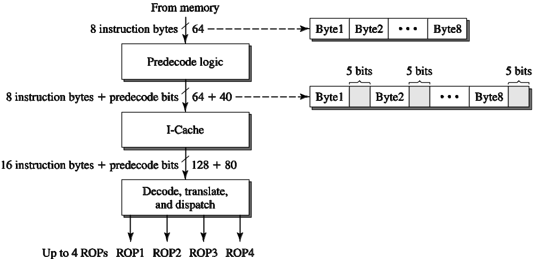
Predecoding in the AMD K5
Notes:
K5: notoriously late and slow, but still interesting (AMD’s first non-clone x86 processor)
~50% larger I$, predecode bits generated as instructions fetched from memory on a cache miss:
Powerful principle in architecture: memoization!
Predecode records start and end of x86 ops, # of ROPs, location of opcodes & prefixes
Up to 4 ROPs per cycle.
Also useful in RISCs:
PPC 620 used 7 bits/inst
PA8000, MIPS R10000 used 4/5 bits/inst
These used to ID branches early, reduce branch penalty

Slide 10
Instruction Dispatch and Issue
Parallel pipeline
  Centralized instruction fetch
  Centralized instruction decode
Diversified pipeline
  Distributed instruction execution

Slide 11
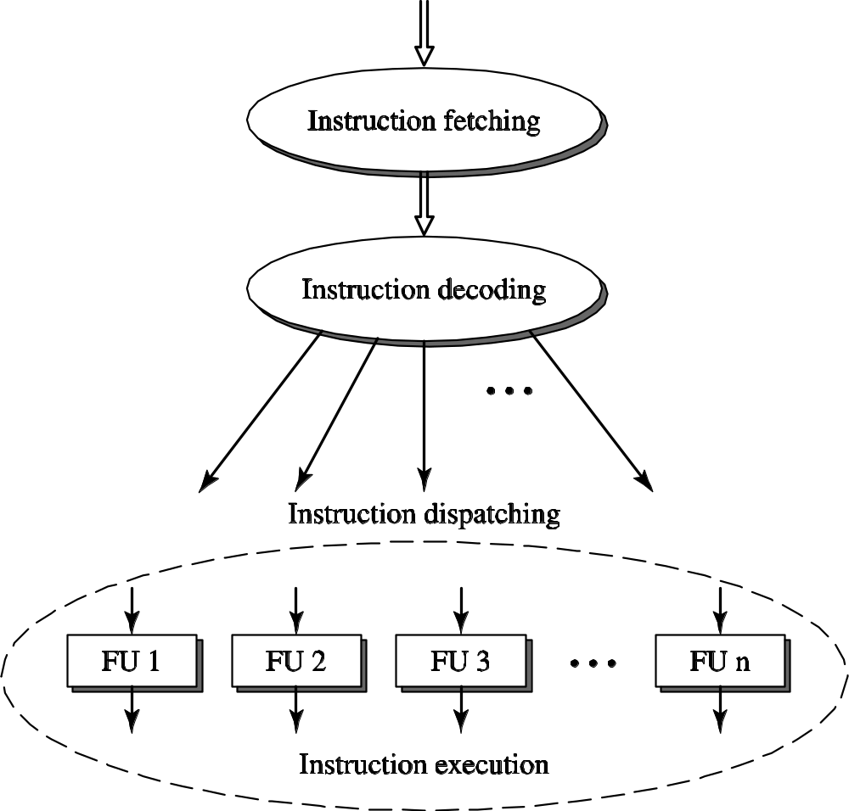
Necessity of Instruction Dispatch
Notes:
Must have complex interstage buffers to hold instructions to avoid rigid pipeline

Slide 12
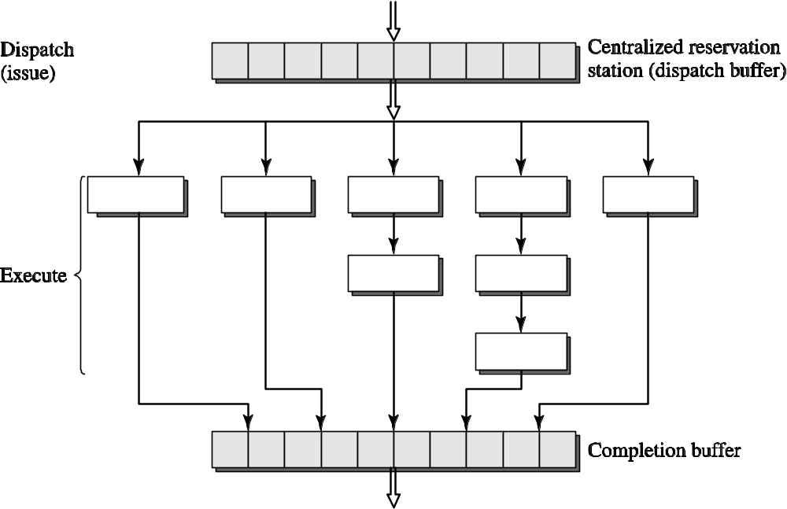
Centralized Reservation Station
Notes:
Dispatch: based on type; Issue: when instruction enters functional unit to execute (same thing here)
Centralized: efficient, shared resource; has scaling problems (later)

Slide 13
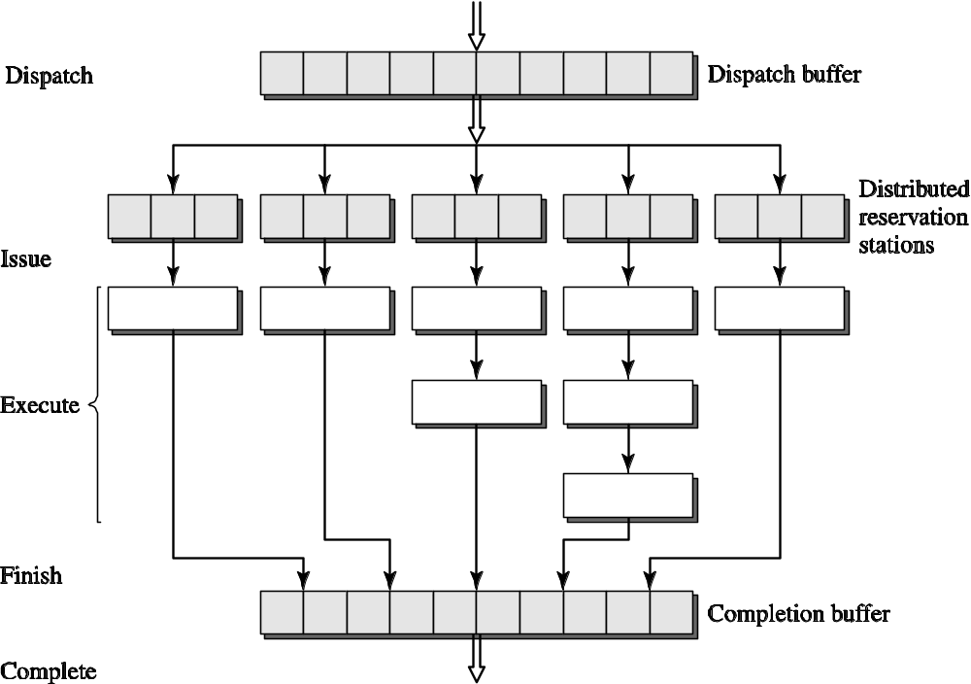
Distributed Reservation Station
Notes:
Distributed, with localized control (easy win: break up based on data type, I.e. FP vs. integer)
Less efficient utilization, but each unit is smaller since can be single-ported (for dispatch and issue)
Must tune for proper utilization
Must make 1000 little decisions (juggle 100 ping pong balls)

Slide 14
Issues in Instruction Execution
Current trends
  More parallelism ⬅ bypassing very challenging
  Deeper pipelines
  More diversity
Functional unit types
  Integer
  Floating point
  Load/store ⬅ most difficult to make parallel
  Branch
  Specialized units (media)
Notes:
RAW/WAR/WAW for load/store requires 32-bit or 64-bit comparators (not 5-6 as in pipelined processor with register identifiers)

Slide 15
Bypass Networks
I-Cache
PC
Fetch Q
BR
Scan
Decode
BR
Predict
FP
Issue Q
FX/LD 1
Issue Q
FX/LD 2
Issue Q
BR/CR
Issue Q
Reorder Buffer
FP1
Unit
FP2
Unit
FX1
Unit
LD1
Unit
LD2
Unit
FX2
Unit
CR
Unit
BR
Unit
StQ
D-Cache
O(n²) interconnect from/to FU inputs and outputs
Associative tag-match to find operands
Solutions (hurt IPC, help cycle time)
  Use RF only (Power4) with no bypass network
  Decompose into clusters (21264)
Notes:
Draw bypass between integer/br/cr units; 4 sources, 12 sinks

Slide 16
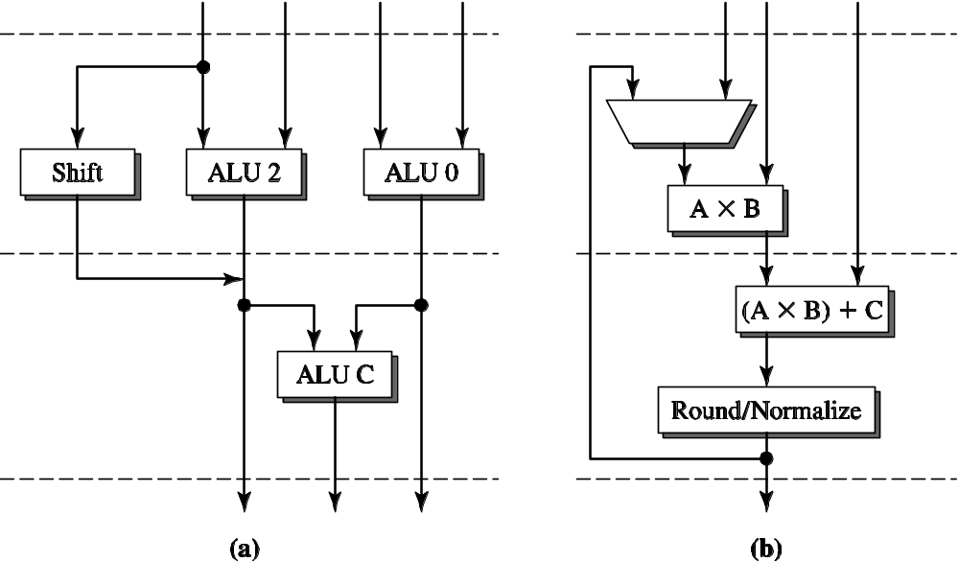
Specialized units
Notes:
NOTE TO SELF: update this to look at e.g. staggered adders in Pentium 4 instead (lose HW problem in Ch 3, though…)
TI SuperSPARC integer unit: inorder processor, didn’t want to stall dual issue of two dependent ops. Can still issue, second op executed by ALU C
IBM POWER/PowerPC FMA or MAF: 3 source operands (loss of regularity in ISA)
MIPS R8000 also had this
MIPS R10000 (OOO) gave up on it, decode cracks FMA into M and A

Slide 17
New Instruction Types
Subword parallel vector extensions
  Media data (pixels, quantized datum)often 1-2 bytes
  Several operands packed in single 32/64b register
    {a,b,c,d} and {e,f,g,h} stored in two 32b registers
  Vector instructions operate on 4/8 operands in parallel
  New instructions, e.g. motion estimation
    me = |a – e| + |b – f| + |c – g| + |d – h|
Substantial throughput improvement
  Usually requires hand-coding of critical loops

Slide 18
Issues in Completion/Retirement
Out-of-order execution
  ALU instructions
  Load/store instructions
In-order completion/retirement
  Precise exceptions
  Memory coherence and consistency
Solutions
  Reorder buffer
  Store buffer
  Load queue snooping (later)
Notes:
Precise exception – clean instr. Boundary for restart
Memory consistency – WAW, also subtle multiprocessor issues (in 757)
Memory coherence – RAR expect later load to also see new value seen by earlier load

Slide 19
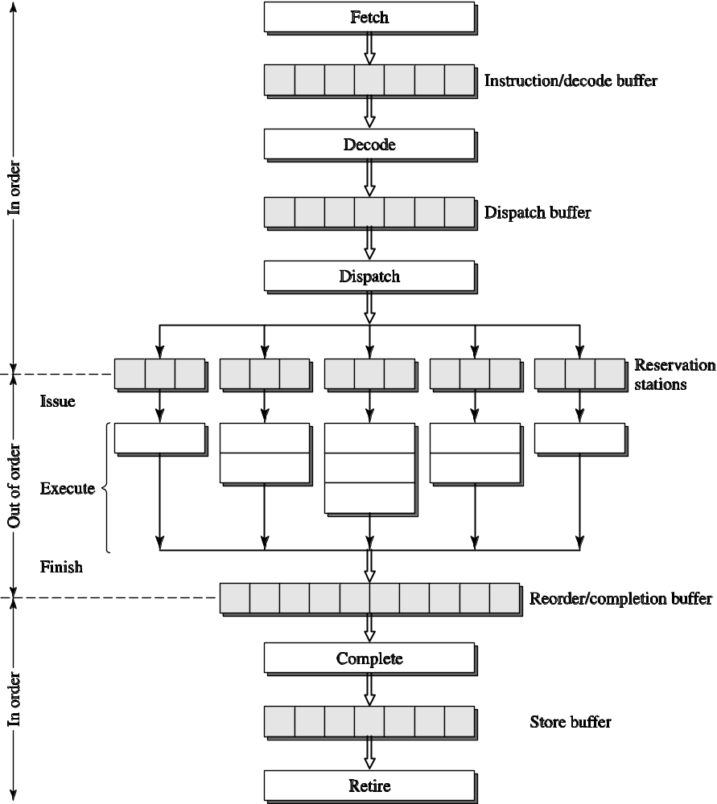
A Dynamic Superscalar Processor
Notes:
ROB – preallocated at dispatch: bookkeeping, store results, forward results (possibly)
Complete – commit results to RF (no way to undo)
Retire – memory update: delay stores to let loads go early

Slide 20
Impediments to High IPC

Slide 21
Superscalar Summary
Instruction flow
  Branches, jumps, calls: predict target, direction
  Fetch alignment
  Instruction cache misses
Register data flow
  Register renaming: RAW/WAR/WAW
Memory data flow
  In-order stores: WAR/WAW
  Store queue: RAW
  Data cache misses

